Slide 1
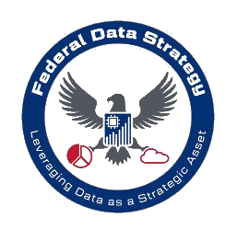

Understanding Federal Data
Governance
Policies
Presented by: Hamza Siddiqui

Slide 2
TABLE OF CONTENTS
01
02
03
04
05
06
Federal Data Strategy
2020 Action Plan
Agency Actions
Why FDS was introduced &
It’s vision
Success & Lessons Learned
Implementing new data standards
Shared Solution Actions
Looking Ahead…
Challenges in implementation
Delivering continually on previous milestone
FDS 10-Year Vision
You can describe the topic of the section here
Data& Society

Slide 3
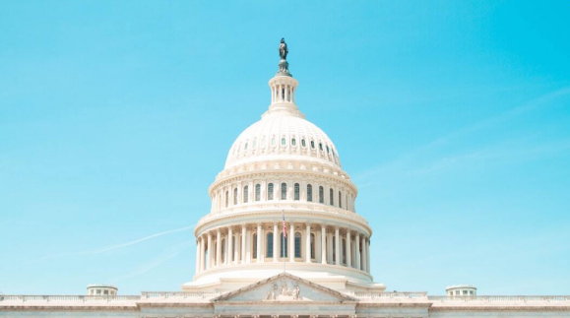
01
Federal Data Strategy
Why FDS was introduced &
It’s vision

Slide 4
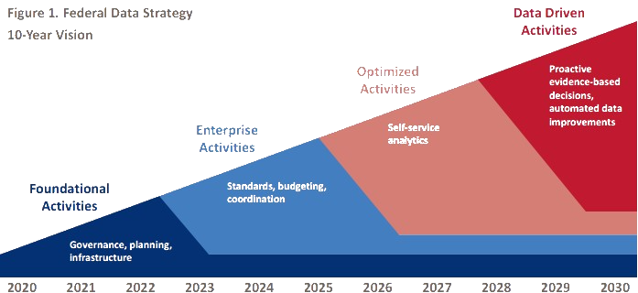
FDS Mission
Core Objectives
2021 Focus
Establish a government-wide vision for federal data management by 2030.
Ensure consistent, reliable, and privacy-preserving access to data.
Increase data sharing and usability for decision-making.
Strengthen agency capacity through tools, models, and training.
Build governance, planning, and infrastructure foundations.
Empower Chief Data Officers (CDOs) to lead ambitious but achievable goals.
Notes:
The Federal Data Strategy, introduced through Memorandum M-19-18, outlines how federal agencies should manage and use data to deliver better services and outcomes by 2030.
It aligns federal data use with emerging priorities like privacy, security, and evidence-based policymaking.
Foundational Activities (2020-2022): Focus on governance, infrastructure, and planning to set a strong baseline.
Enterprise Activities (2023-2025): Establish data standards and align budgets with long-term data strategies.
Optimized Activities (2026-2028): Enable self-service analytics to empower stakeholders.
Data-Driven Activities (2029-2030): Realize automated, proactive decision-making through advanced data practices.
2021 Action Plan:
2021 builds on the successes of 2020. Agencies are focused on:
Strengthening governance bodies and planning.
Addressing data maturity and filling skill gaps.
Standardizing best practices to ensure scalability.
Role of CDOs and the Chief Data Officer Council in coordinating efforts across agencies.
FDS aims for consistency and integration—ensuring that every federal agency operates with robust, standardized data practices.
A note on flexibility, the FDS accommodates varying levels of agency data maturity and evolving priorities.

Slide 5

02
2020 Action Plan
Successes & Lessons Learned

Slide 6
Foundations for FDS
Governance
Planning
Established the Federal Chief Data Officer (CDO) Council for collaboration.
Created cross-agency initiatives like the COVID-19 Working Group
Conducted operational maturity assessments to establish baselines.
Launched data upskilling programs and developed tools like the Data Skills Catalog.
01
02
02
Infrastructure
Lessons Learned
Improved data inventories on Data.gov for transparency and usability.
Piloted tools for AI research and data management
03
04
Foster flexibility and collaboration through interagency councils.
Align milestones with budgets and ensure clear guidance.
Notes:
Governance Successes:
The CDO Council created a collaborative environment to standardize governance practices.
Initiatives like the COVID-19 Working Group addressed real-time challenges using cross-agency data collaboration.
Planning Successes:
Maturity assessments provided a roadmap for agencies to improve their data governance and operations.
Data upskilling programs, like the pilot cohort of 61 federal employees, addressed workforce gaps.
Infrastructure Successes:
Agencies indexed data assets on Data.gov, making them accessible and actionable for the public and researchers.
Pilot tools like the One-Stop Researcher Application, which streamline data management and access.
Lessons Learned:
Importance of flexibility, as agencies have varying levels of maturity and resources. Collaboration through councils like the CDO Council ensures shared learning.
Aligning milestones with budget cycles prevents delays and facilitates long-term planning.

Slide 7
03
Agency Actions
2021 Focus & Goals for Improvement

Slide 8
Building on Lessons Learned
The 2021 Action Plan builds on 2020's lessons, focusing on improving foundational governance, planning, and infrastructure while preparing agencies for enterprise-level activities by 2023.
Agencies are encouraged to assess capabilities, prioritize activities that align with their missions, and leverage flexibility to address diverse maturity levels and needs.

Slide 9
6 Agency Actions of 2021
1.Gather and Assess Data Identified for Priority Agency Questions
2.Mature Data Governance
3. Data and Infrastructure Maturity
4. Increase Staff Data Skills
5. Publish Agency Open Data Plans
6. Improve Data Inventories
See speaker notes for more details…
Notes:
Action 1: Gathering and Assessing Data
Last year, agencies began identifying data needs for key questions.
This year, the focus is on data quality. Data must be fit for purpose.
Agencies will assess quality using existing frameworks, considering privacy and security.
Data assets will be incorporated into inventories, linked to specific Learning Agenda questions.
Action 2: Maturing Data Governance
Agencies have made progress in data governance, establishing CDOs and Data Governance Bodies.
This year, the goal is to set clear, multi-year goals for Data Governance Bodies.
This demonstrates commitment to the Federal Data Strategy and improves data management.
Agencies will focus on improving data management, data use, and priority projects.
Action 3: Data and Infrastructure Maturity
Building on 2020, agencies will leverage data strategies and maturity assessments in planning.
Data needs supporting the mission and FDS will be analyzed.
Business cases for data infrastructure investments may be developed.
Future budgets will reflect data needs, and investments will be identified in IT Capital Planning.
Action 4: Increasing Staff Data Skills
2020 focused on assessing data skills and creating improvement plans.
This year, the focus is on implementation. Plans will be prioritized and data skills incorporated into Capacity Assessments.
Data literacy will be improved, training offered, and hiring may occur.
The goal is a data-literate workforce with strong data skills.
Action 5: Publishing Agency Open Data Plans
Agencies will continue identifying key data for open data plans, aligning with the Evidence Act and OMB guidance.
The focus will be on data supporting COVID-19 response and AI research.
Action 6: Improving Data Inventories
Data inventories must be complete and up-to-date.
Smaller agencies may need to create inventories and list them on Data.gov.
Larger agencies should focus on clarity and comprehensiveness, utilizing metadata.

Slide 10
04
Community of Practice and Shared Solution Actions
Community of Practice Actions: These are specific projects led by groups of agencies working together on common data challenges.
Shared Solution Actions: These are government-wide initiatives, led by specific agencies, to create solutions that benefit all agencies.

Slide 11
5 Shared Actions of 2021
1.Artificial Intelligence and Automation
2.Government-Wide Dashboards and Infrastructure
3. Data Skills Workforce Development
4. Interagency Wildland Fire Fuels Data Management
5. Geospatial Data Practices
See speaker notes for more details…
Notes:
Action 7: Artificial Intelligence and Automation
Key Points:
Executive Orders 13859 and 13960 provide the foundation for AI in government.
Focus on developing and sharing AI use cases.
Increase government AI expertise.
Release an open-source Algorithmic Assessment Tool.
Action 8: Government-Wide Dashboards and Infrastructure
Key Point:
Develop a government-wide approach to data-driven decision-making.
Create a proof-of-concept for shared interagency dashboards.
Action 9: Data Skills Workforce Development
Key Point:
Develop a data-skills workforce development playbook to guide agencies in training their staff.
Action 10: Interagency Wildland Fire Fuels Data Management
Key Point:
Improve data management for wildland fire fuels data.
Develop a modernization architecture and roadmap for better data sharing and collaboration.
Action 11: Geospatial Data Practices
Key Points:
Identify high-value geospatial data investment areas.
Improve coordination and collaboration between the Federal Geographic Data Committee and interagency councils.

Slide 12
Impact of the changes for Government Data Governance
Building on 2020: The 2021 Action Plan builds on the momentum from 2020 by prioritizing cross-agency collaboration and shared solutions. This will help us achieve greater efficiency and effectiveness in our use of data.
Long-Term Vision: The FDS is a ten-year roadmap for leveraging data to improve government services and decision-making. It outlines a comprehensive strategy for using data to benefit the American people.
Iterative Approach: Future Action Plans will continue to evolve and adapt. We will build on our successes, incorporate emerging technologies, and align with federal policies and programs. This iterative approach ensures that the FDS remains relevant and effective.

Slide 13
Potential Challenges for Implementation of FDS
Agency Needs and Maturity: Agencies have diverse missions, resources, and data maturity levels. A "one-size-fits-all" approach may not be effective.
Data Quality and Security: Agencies need to ensure the quality, accuracy, and security of the data they collect, manage, and share.
Workforce Development: Many agencies lack the necessary workforce with data skills to implement the FDS effectively.
Funding and Resources: Implementing the FDS requires sustained investment in data infrastructure, technology, and personnel.
Data Sharing and Collaboration: Effective data sharing across agencies and with the public requires strong governance frameworks and collaboration mechanisms.
Privacy Considerations: Agencies must balance the benefits of data sharing with the need to protect individual privacy.

Slide 14

THANKS!
Do you have any questions?
hssiddiqui99@gmail.com (832) 782-9837
Hamza Siddiqui
Data& Society

